Slide 1

Low-fi Prototyping & Pilot Usability Testing

Slide 2
Hello!
We are HELM

Slide 3


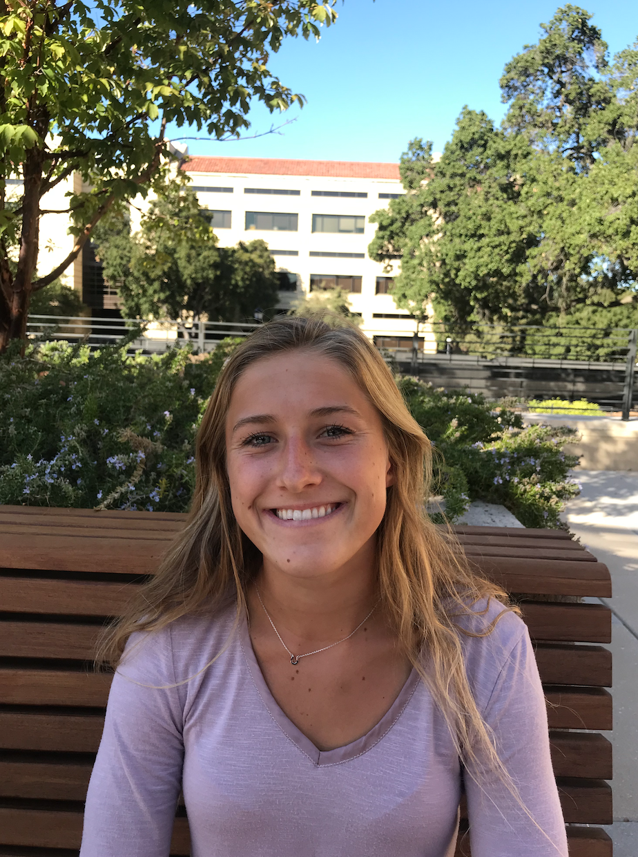


Slide 4


Slide 5
Roadmap
Value Proposition
Selected Interface
Low-fi Prototype
Tasks
Experimental Method
Experiment Results

Slide 6
Roadmap
Value Proposition
Selected Interface
Low-fi Prototype
Tasks
Experimental Method
Experiment Results

Slide 7
Value Proposition
Crowdsourced Lesson Planning and Organization
Notes:
Mission: improve quality of education by empowering teachers

Slide 8
Roadmap
Value Proposition
Selected Interface
Low-fi Prototype
Tasks
Experimental Method
Experiment Results

Slide 9
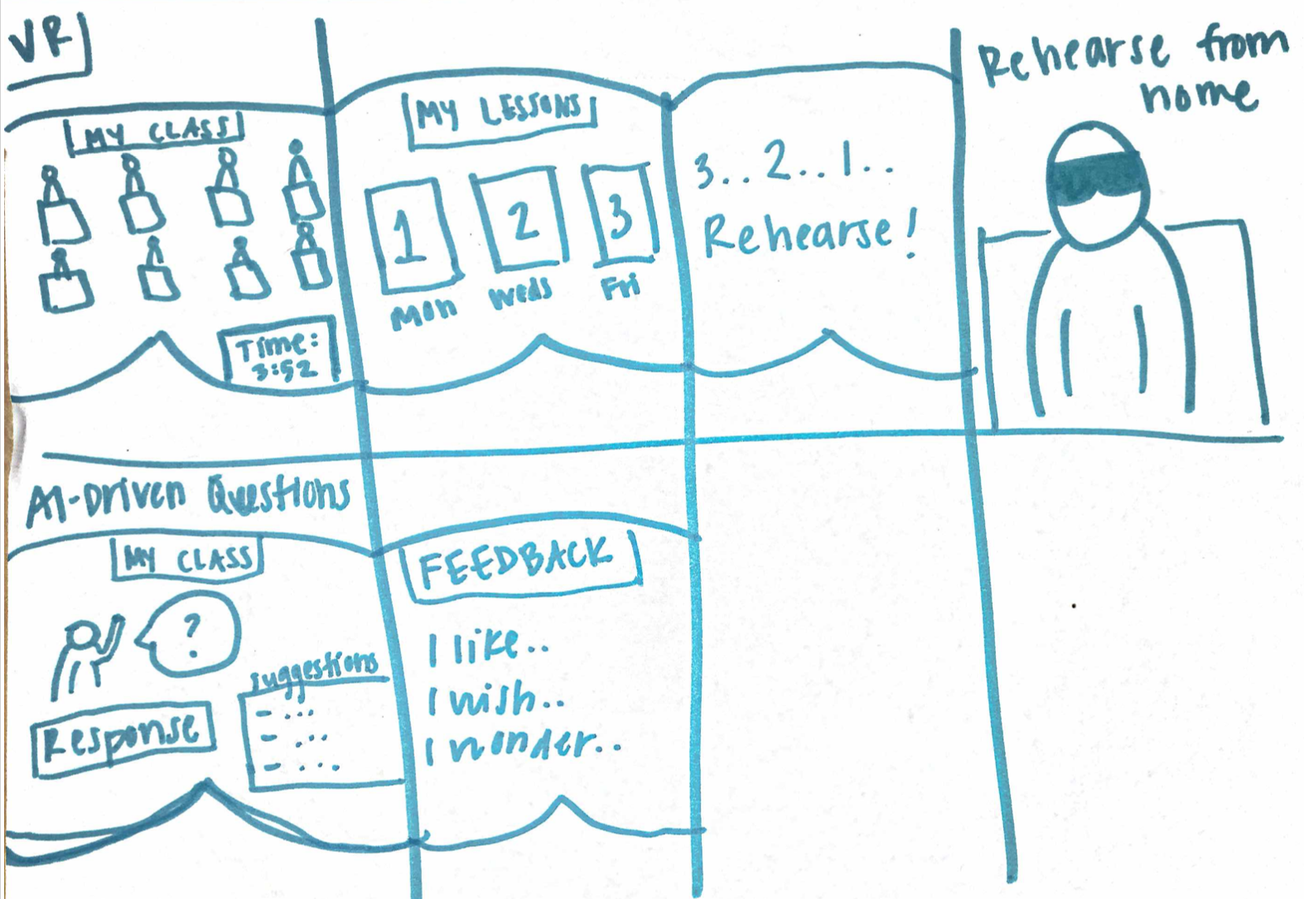
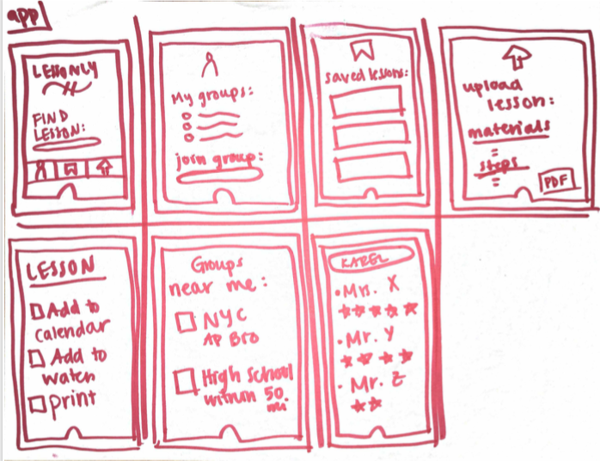
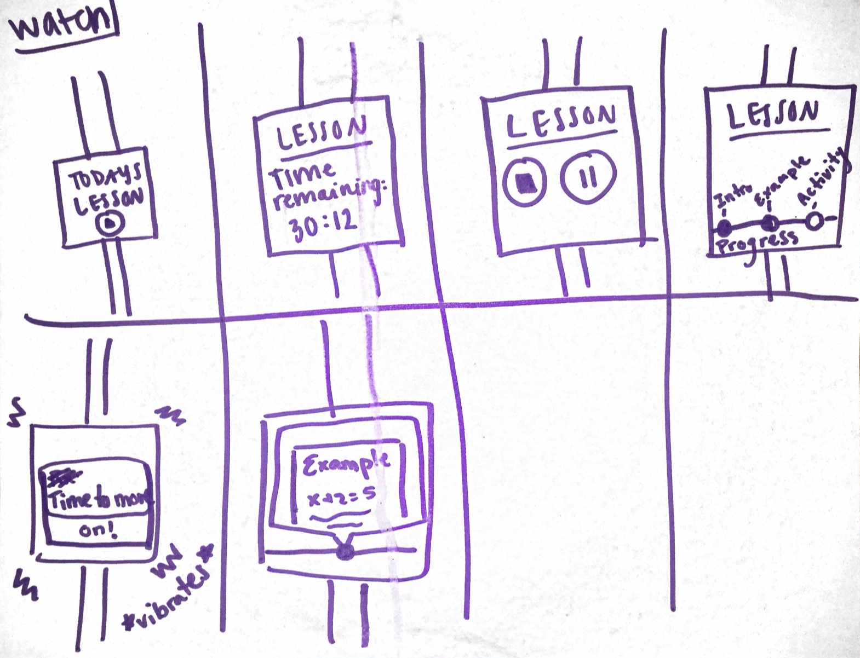
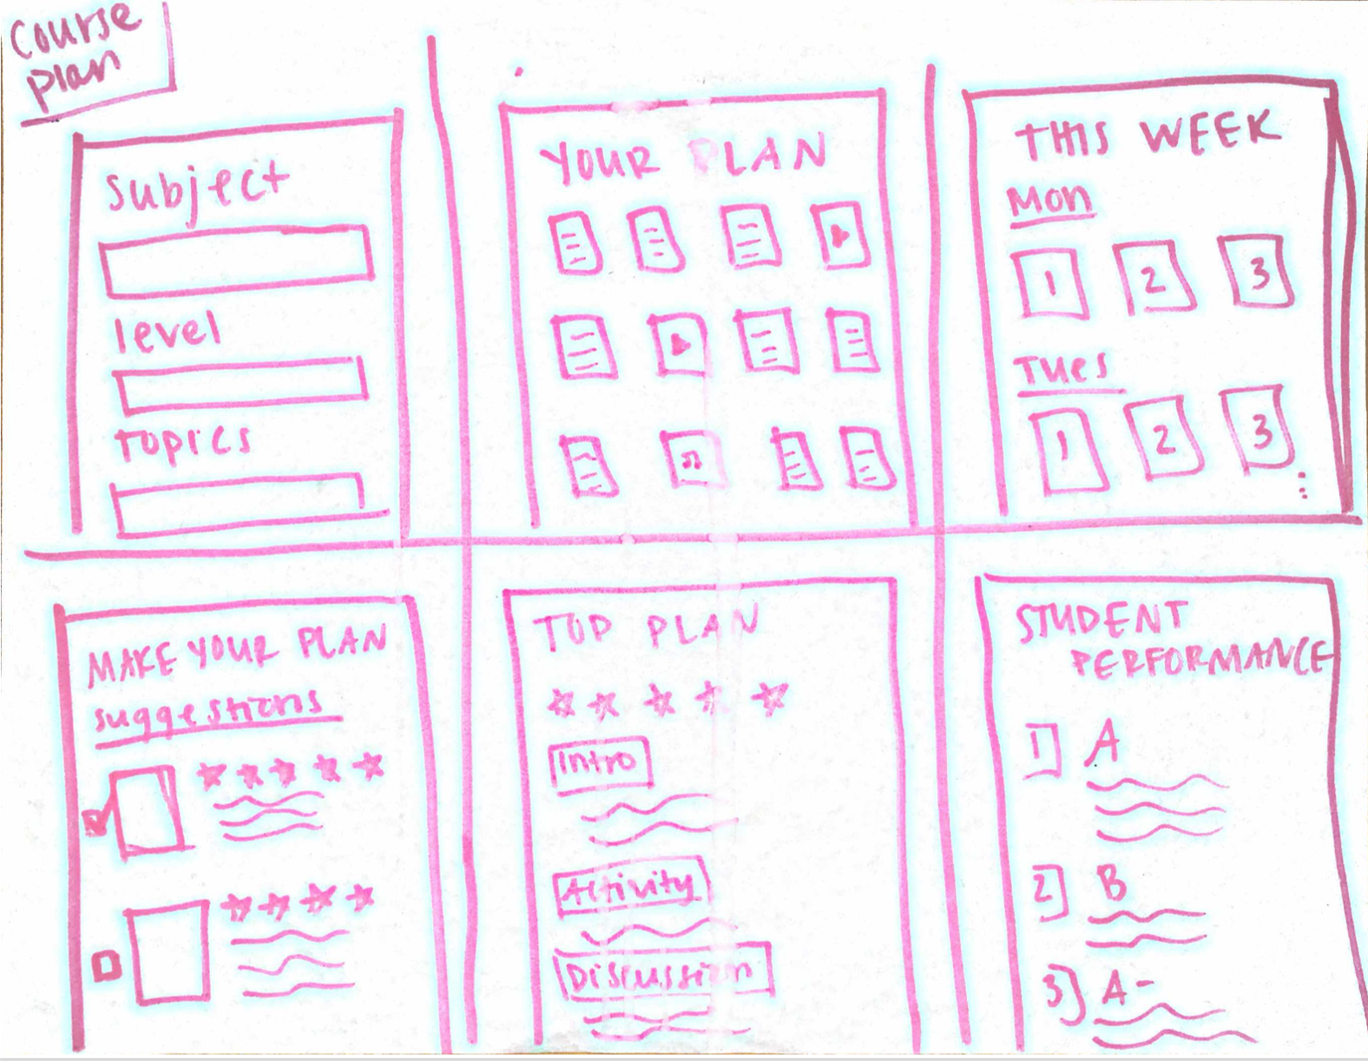
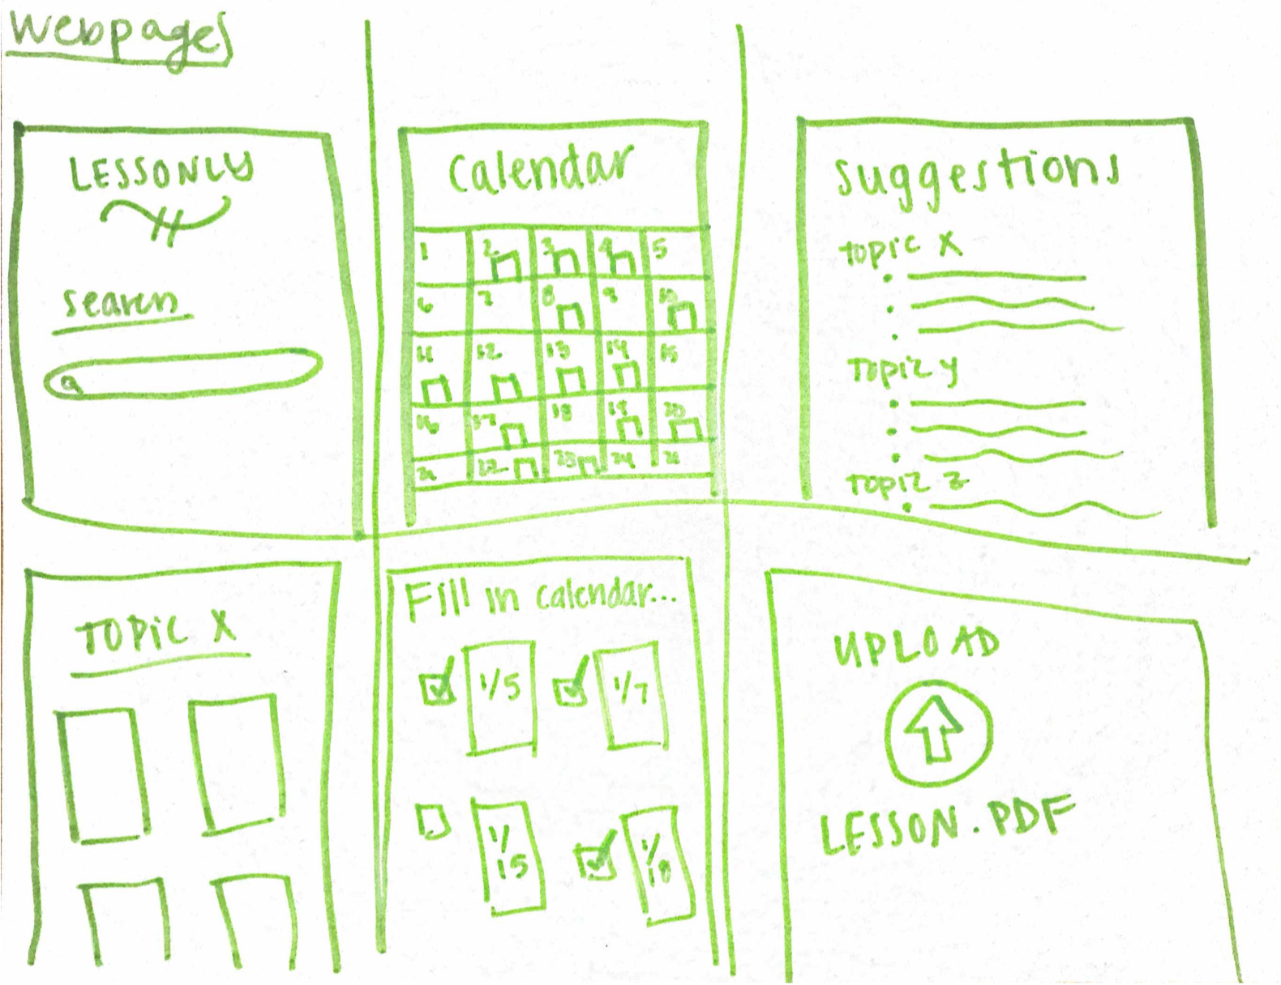
Initial Sketches
Notes:
Interviewed at Cafe Borrone’s

Slide 10
Initial Sketches
Notes:
Interviewed at Cafe Borrone’s

Slide 11
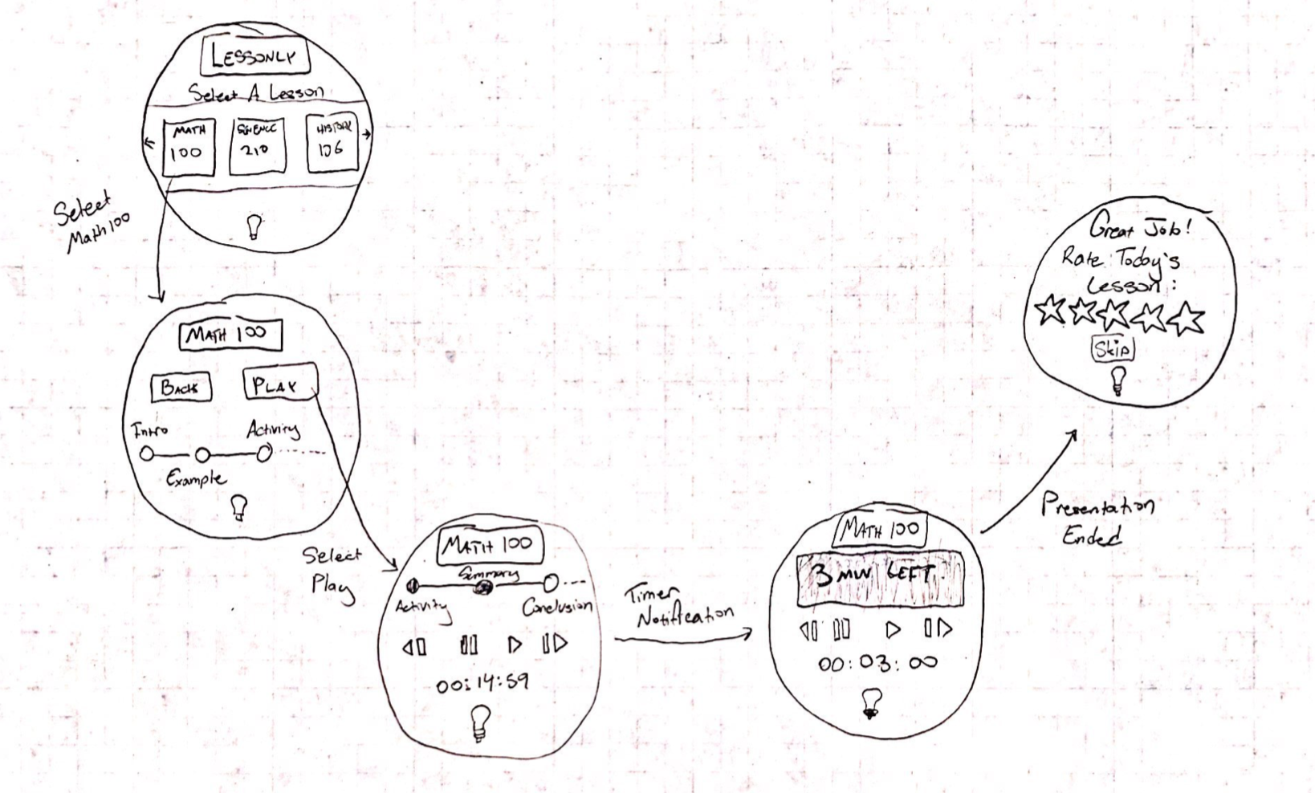
Top Two
Notes:
Interviewed at Cafe Borrone’s

Slide 12
[Pros]
Many features
Simple interface
User friendly
Seamless lifestyle
integration
Offline potential
[Cons]
Functions like a feature
Less versatile
Small screen
Assistant, not planner

Slide 13
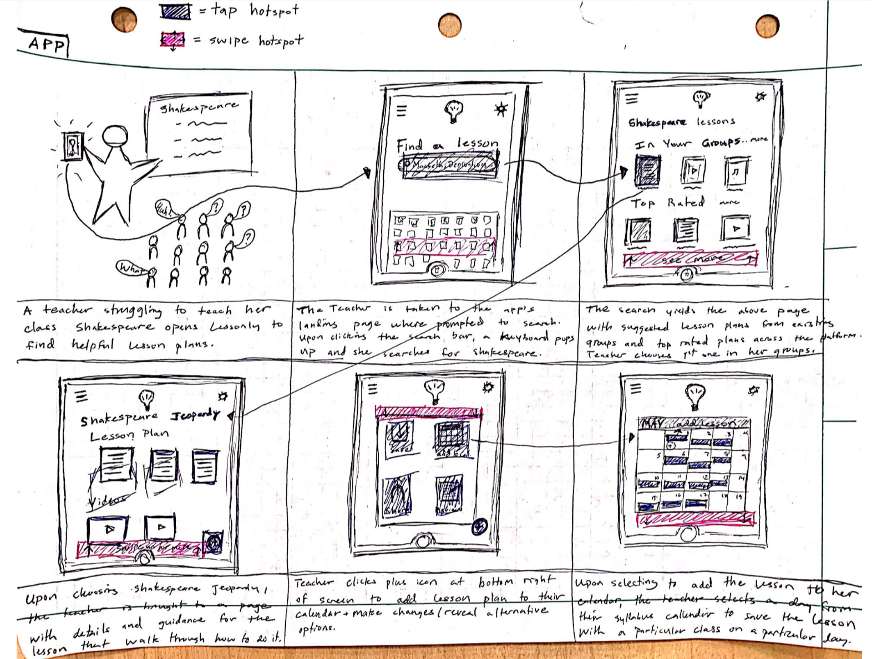
Top Two
Notes:
Interviewed at Cafe Borrone’s

Slide 14
[Pros]
Many features
Integrations
Social/community
Storing + organizing
[Cons]
Teachers + apps
Features = overwhelming
Roaming/data
Lesson scanning can be
frustrating

Slide 15
Selected Interface
Notes:
Interviewed at Cafe Borrone’s

Slide 16
Rationale
High Functionality
User Friendly

Slide 17
Roadmap
Value Proposition
Selected Interface
Low-fi Prototype
Tasks
Experimental Method
Experiment Results

Slide 18
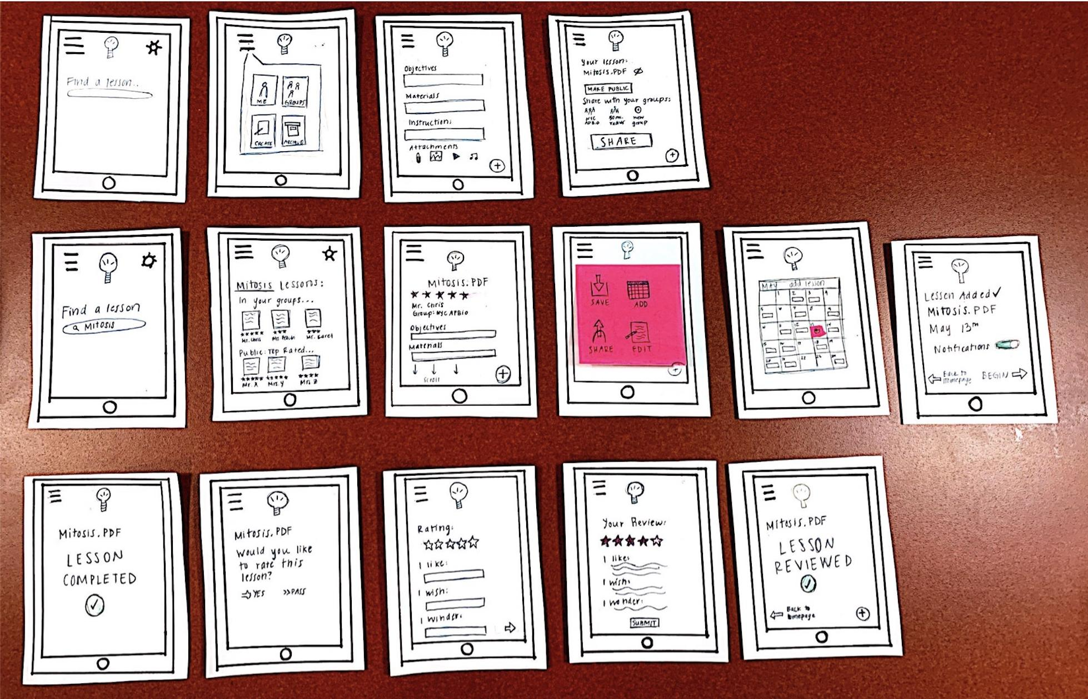
Low-fi Prototyping
Notes:
Paper

Slide 19
Roadmap
Value Proposition
Selected Interface
Low-fi Prototype
Tasks
Experimental Method
Experiment Results

Slide 20
Our Tasks
Keep a record of an effective lesson plan
Give feedback to others on a lesson plans
Find an excellent lesson plan on short notice
Notes:
Interviewed at Cafe Borrone’s

Slide 21
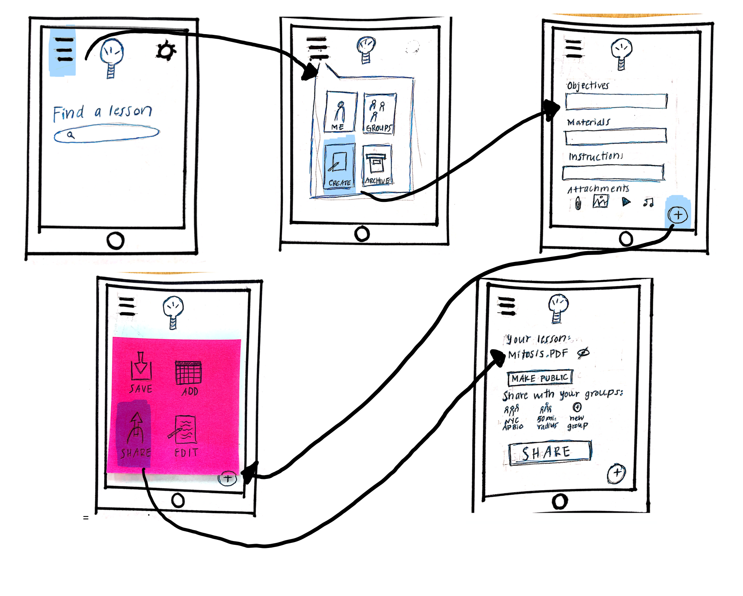
Simple - Create a lesson
Notes:
Interviewed at Cafe Borrone’s

Slide 22
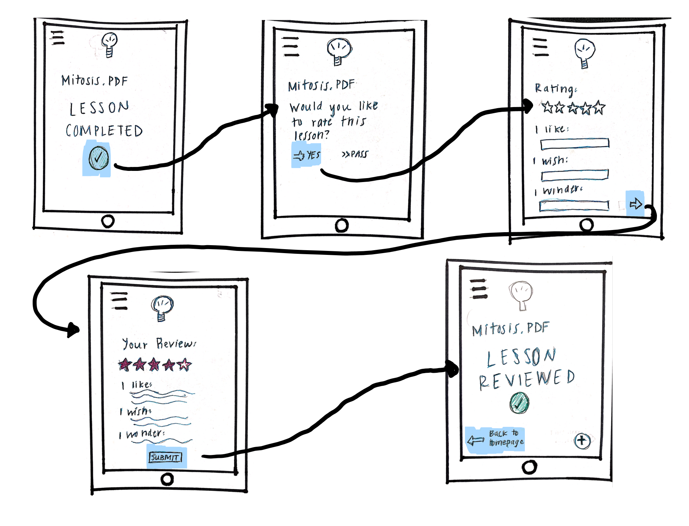
Moderate - Give feedback
Notes:
Interviewed at Cafe Borrone’s

Slide 23
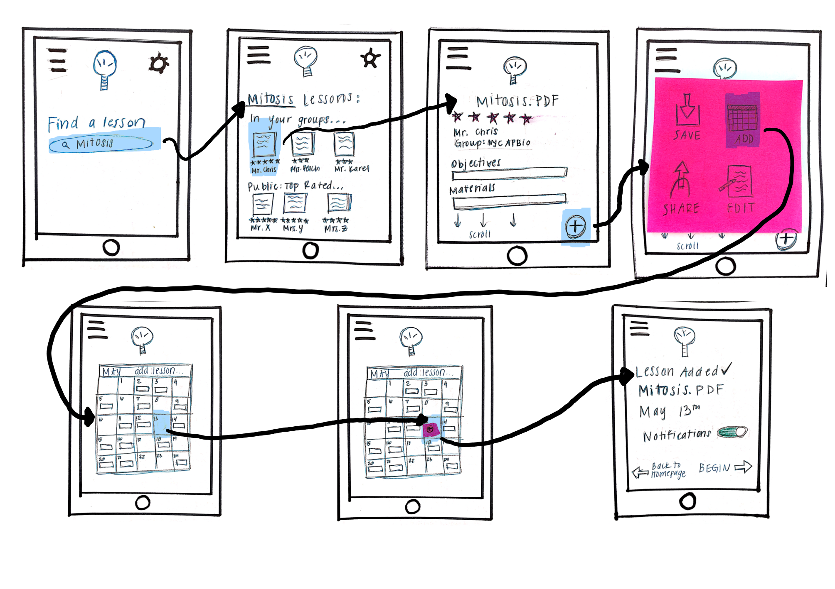
Complex - Find a lesson
Notes:
Interviewed at Cafe Borrone’s

Slide 24
Roadmap
Value Proposition
Selected Interface
Low-fi Prototype
Tasks
Experimental Method
Experiment Results

Slide 25
Experimental Method
Roles
Procedure
Measurements
2 greeters/facilitators
1 computer
1 observer/notetaker
Introductions
Task performance
Feedback → Q&A
Time spent on tasks
Mistakes made
Confidence
4 point severity scale
Notes:
Interviewed at Cafe Borrone’s

Slide 26
Participants - 3 T’s
Teacher
Tutor
TA
High school
Large Classes
Subject specialty
Grammar school
One-on-One
General HW help
Stanford University
Small groups
CS lessons + help
Notes:
Interviewed at Cafe Borrone’s

Slide 27
Roadmap
Value Proposition
Selected Interface
Low-fi Prototype
Tasks
Experimental Method
Experiment Results

Slide 28
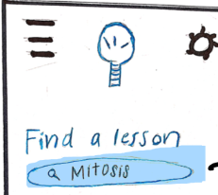

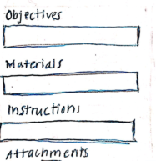
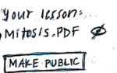
Experiment #1 - Create
“Add” menu is intuitive and useful
Appreciative of ability to control privacy/share selectively
Prominent share button = great
Confused on which icon to pick on landing page
“Objective” section unclear
Public setting caused initial confusion

Slide 29
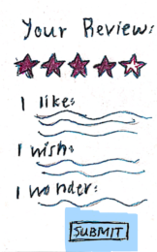


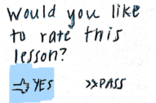

Experiment #2 - Feedback
Like seeing full summative report
Easy to submit with arrow icons
Overall, icons were a hit and intuitive
Check icon was persistent source of confusion
What about not wanting to rate lesson?
“I wonder” box = unintuitive

Slide 30
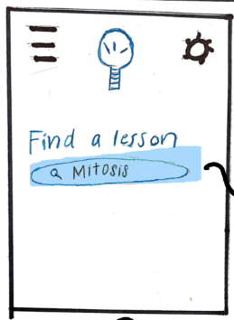
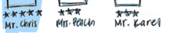
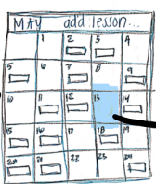
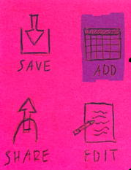
Experiment #3 - Find
Star rating system was popular
Once understood, calendar option was a hit
Groups feel safe/effective
Uncertainty with no visible keyboard
Unsure how to submit search
Teachers use first names
Add to calendar initially unintuitive

Slide 31
Suggested UI Changes
Landing page needs additional direction to lead user to search bar/menu
Prioritize groups, don’t default to public
Add descriptions for a few of the progressive icons
Notes:
Progressive meaning icons that direct you to the next page -- also should just have more direction in general

Slide 32
Summary
[Extensive sketching → app interface]
[Systematically test 3 participants]
→ Overall, participants enjoyed and understood
→ UI needs direction, transparency, intuitive iconography

